Slide 1
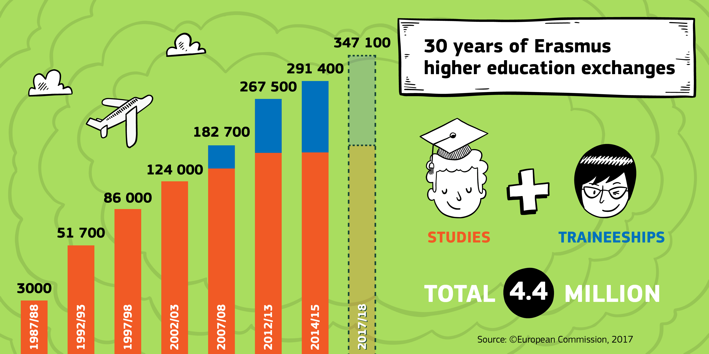
Figure 1
Number of Erasmus Students
( European Commission, 2017)

Slide 2
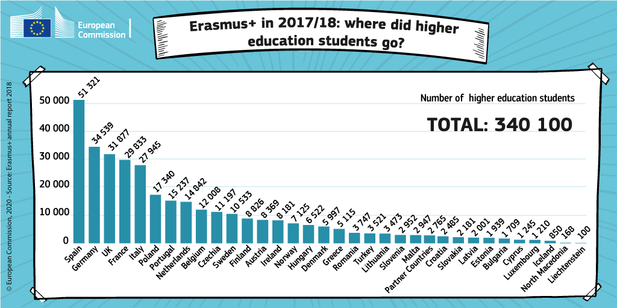
Figure 2
Most Popular Destinations for Erasmus Students
( European Commission, 2018)

